Slide 1
MAJOR SOURCE REQUIREMENTS FOR PM2.5 SERIOUS CLASSIFICATION
INFORMATION MEETING

Slide 2
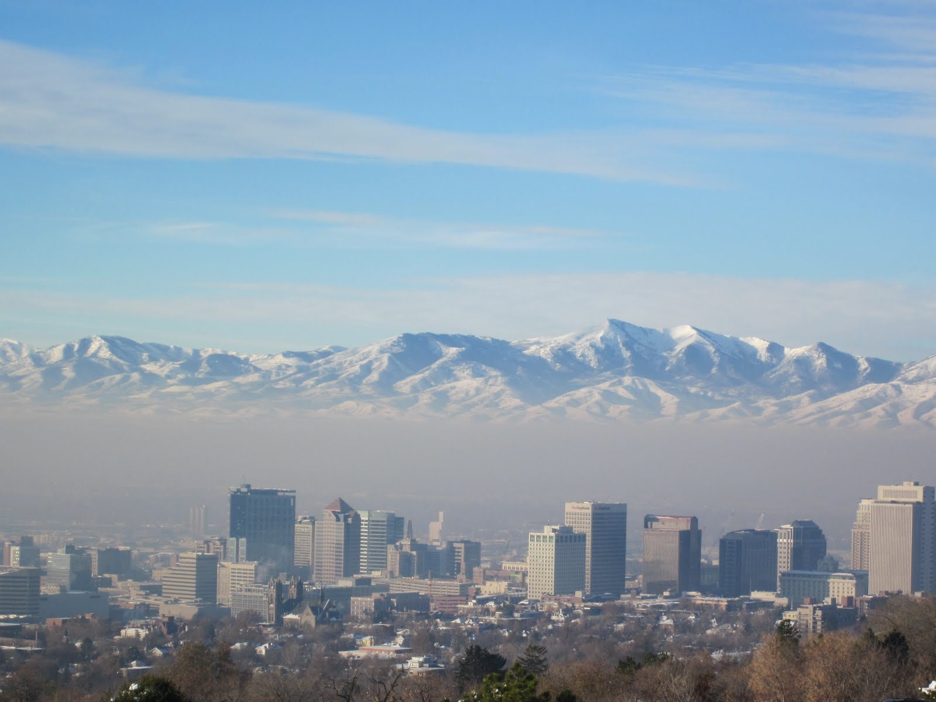
Why am I Here?
Some of you already know… those above 100 tpy
Some of you are new… those between 70 and 100
…I’ll give a little background for those who are new
Notes:
Slide 1 (opening picture)

Slide 3
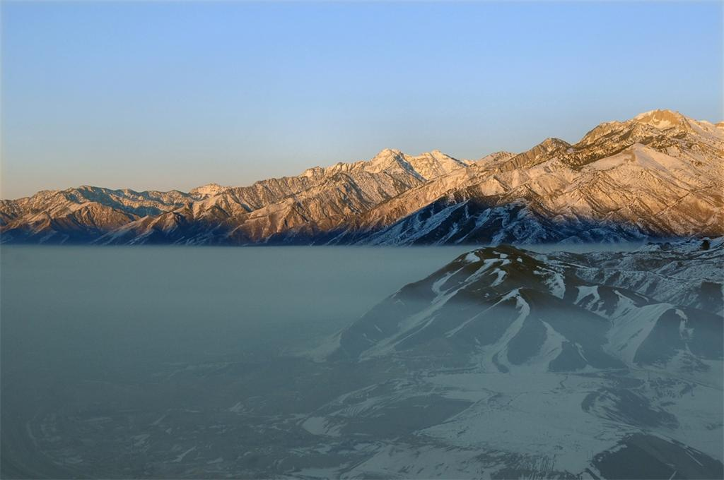
Utah continues to have trouble with fine PM (PM_{2.5})
It’s the wintertime smog we’re all too familiar with.
Most of it is what we call Secondary PM.
Not directly released as such, but Precursors to PM react chemically to become particles
Winter provides the right conditions for this transformation, and temperature inversions also act to trap what we emit.

Slide 4
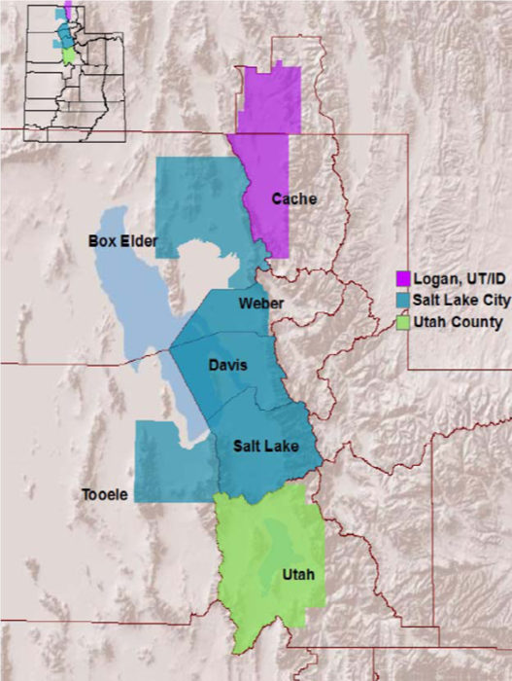
Utah is out of compliance with the 24-hr federal health standard for PM_{2.5}
This standard (lowered in 2006) required that Utah do the following:
Designate all areas of the state as either attainment or nonattainment (see map)
Write a state implementation plan (SIP) to bring non-attaining areas back into attainment
Point Sources above 100 tpy were required to meet RACT.
PM_{2.5} nonattainment areas

Slide 5
Utah gave EPA its SIPs for these areas in 2014.
These were Moderate Area SIPs
Each nonattainment area had until December 31, 2015 to monitor attainment of the 24-hr health standard.
None of the three areas was able to do so.
By law, this means that EPA will re-classify our nonattainment areas from Moderate to Serious.
Utah will now have to give EPA another plan for each area.

Slide 6
New SIPs for Serious Areas
SIP requirements for stationary “Point” Sources are more rigorous for Serious Area Plans.
Permitting requirements are also more rigorous in Serious Nonattainment Areas.
The Serious Area SIPs will be required in addition to the Moderate Area SIPs.
…See following table

Slide 7
Major Sources: SIP and NNSR Requirements
PM2.5 | State Implementation Plan (SIP) |  | New Source Review (NSR)
 | Moderate Area | Serious Area | Within a Serious PM2.5 Nonattainment Area
“Point Source” | * 100 tpy | * 70 tpy | * 70 tons per year (tpy) = “Major Source”
Must Meet: | Source-specific RACT Review | Source-specific BACT Review | BACT and Offsetting Requirements …where “Significance” for “Major Modification” determination is set at: 10 tpy for direct PM2.5 40 tpy for SO2, NOx, and VOC For Ammonia – to be defined in SIP
Then Meet: | Unless Not Able to Demonstrate Attainment by December 31, 2019
 |  | Most Stringent Measures (MSM)
PM2.5 Precursors | SO2, NOx, and VOC | SO2, NOx, VOC, and Ammonia (NH3) | SO2, NOx, VOC, and Ammonia (NH3)
* For PM2.5 or any PM2.5 Plan Precursor

Slide 8
So what does all of that mean?
Estimated date of redesignation: December 15
18-month window
UDAQ is required to implement BACT to demonstrate attainment

Slide 9
Three areas of control
Transportation – vehicles
Area sources – general rules
Major sources – “SIP-listed” sources

Slide 10
All pollutants
BACT applies to all the SIP pollutants:
Primary PM2.5 (including condensables)
SO2
NOx
VOCs
Ammonia (NH3)

Slide 11
So what is BACT?
It is a bit different than what has been applied in your existing AOs.
It is generally independent of demonstrating attainment.
No pre-defined de minimis level.
Concept of “additional feasible measures.”
“Most stringent measures” or MSM.

Slide 12
How is BACT determined?
Essentially similar to BACT under an AO
List of potential controls is broader in scope
Only two ways to reject a control
Technical infeasibility must be documented
Economic infeasibility must be documented
Partial implementation may still “count”
Previous determinations must be re-evaluated as part of the SIP process

Slide 13
BACT determination cont.
Once BACT is determined, this results in a SIP limit or condition.
This may be a general rule
It may be source specific
Each condition also has an associated compliance demonstration requirement also included in the SIP

Slide 14
Most Stringent Measures
MSM controls – the easiest way to think of these are as LAER (lowest achievable emission rate) controls.
Essentially BACT, only without the economic feasibility component.
Basically, if it works – it goes on.

Slide 15
So what does this mean to me?
For the new sources – those above 70 tons.
We feel your pain.
But … you might be able to escape!
For the remaining sources – all of the existing major sources that aren’t likely to fall below 70 tons.
Here we go again.

Slide 16
Emission Reduction Credits for PM_{2.5}
Current status of emission reduction credit registries
The PM₁₀ registry has credits available to offset PM₁₀ and PM₁₀ precursor increases. The credits in this registry cannot be used to offset PM_{2.5} or PM_{2.5} precursors
PM_{2.5} generation and usage will be in accordance with 40 CFR 51 Appendix S until the SIP is approved
The PM_{2.5} registry has few credits

Slide 17
Emission Reduction Credits for PM_{2.5}
Usage of PM_{2.5} ERC
Only needed for significant increases at major sources
Generally can only be used in the nonattainment area they were generated
Interpollutant trading is not allowed
Offsetting of NH₃ not required under Subpart S

Slide 18
Emission Reduction Credits for PM_{2.5}
Generation of PM_{2.5} ERC’s
Permanent, Enforceable, Quantifiable, Surplus
Emissions must be in the baseline emissions inventory. ERC’s generated before development of the inventory cannot be used for PM_{2.5} offsetting
Surplus emissions: shutdowns, curtailments, voluntary controls
Can only be attained pollutant for pollutant

Slide 19
Where can I find out more about the New Federal Requirements?
EPA’s new rule: “Fine PM NAAQS: SIP Requirements” became effective on October 24, 2016. It Revises:
Permitting requirements of 40 CFR 51.165
Provisions for Implementation of PM_{2.5} NAAQS (Subpart Z of 40 CFR; 51.1000)
Find it at: FR Vol. 81, No. 164 / Aug. 24, 2016 (pps. 58010 – 58162)
For details on control strategy requirements for Serious Area PM_{2.5} Plans, See…
40 CFR 51.1010 “Serious area attainment plan control strategy requirements.” (pps. 58157 – 58159)
With clarification provided in paragraph VI. D “Attainment Plan Control Strategy” (pps. 58080 – 58087)

Slide 20
Any Other Questions?

